Slide 1
Public health approaches & implications in weight management
NU.DT 5079
Dr Hilda Mulrooney

Slide 2
What we will cover:
Context: why approaches to weight management are needed
Consideration of different approaches:
Education & social movement (e.g. Change4Life)
Partnership (e.g. Responsibility Deal)
Regulation (e.g. SDIL, marketing, advertising)
Reformulation (e.g. sugar, calories)
Medication

Slide 3
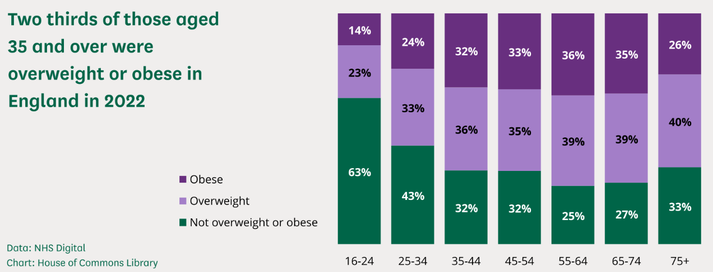
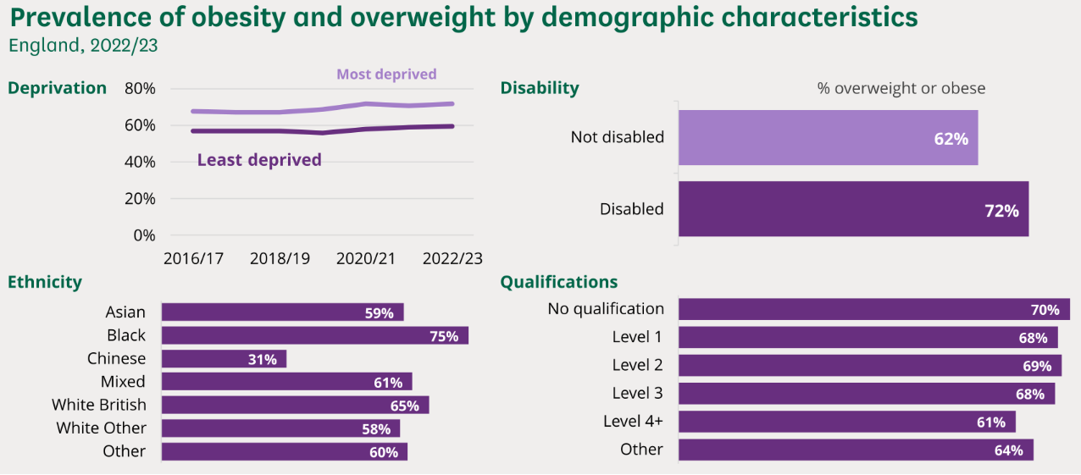
Context: adults
(Stiebahl, 2025)

Slide 4
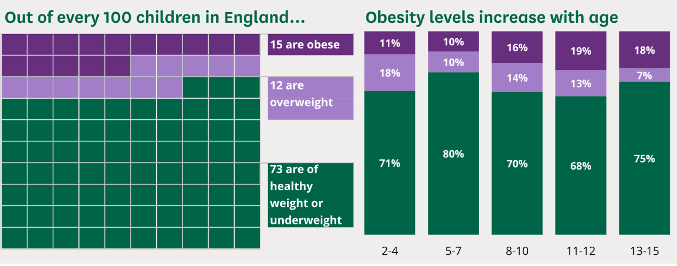
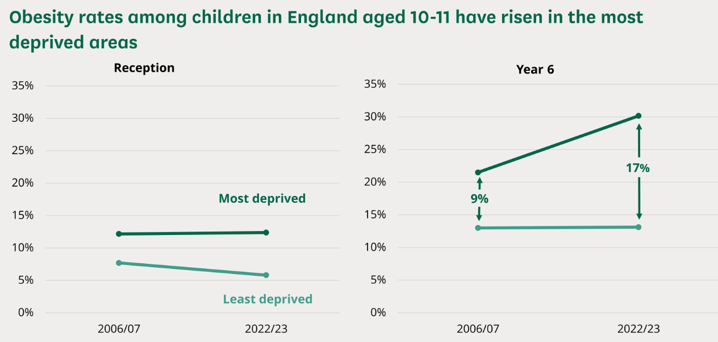
Context: children
(Stiebahl, 2025)

Slide 5
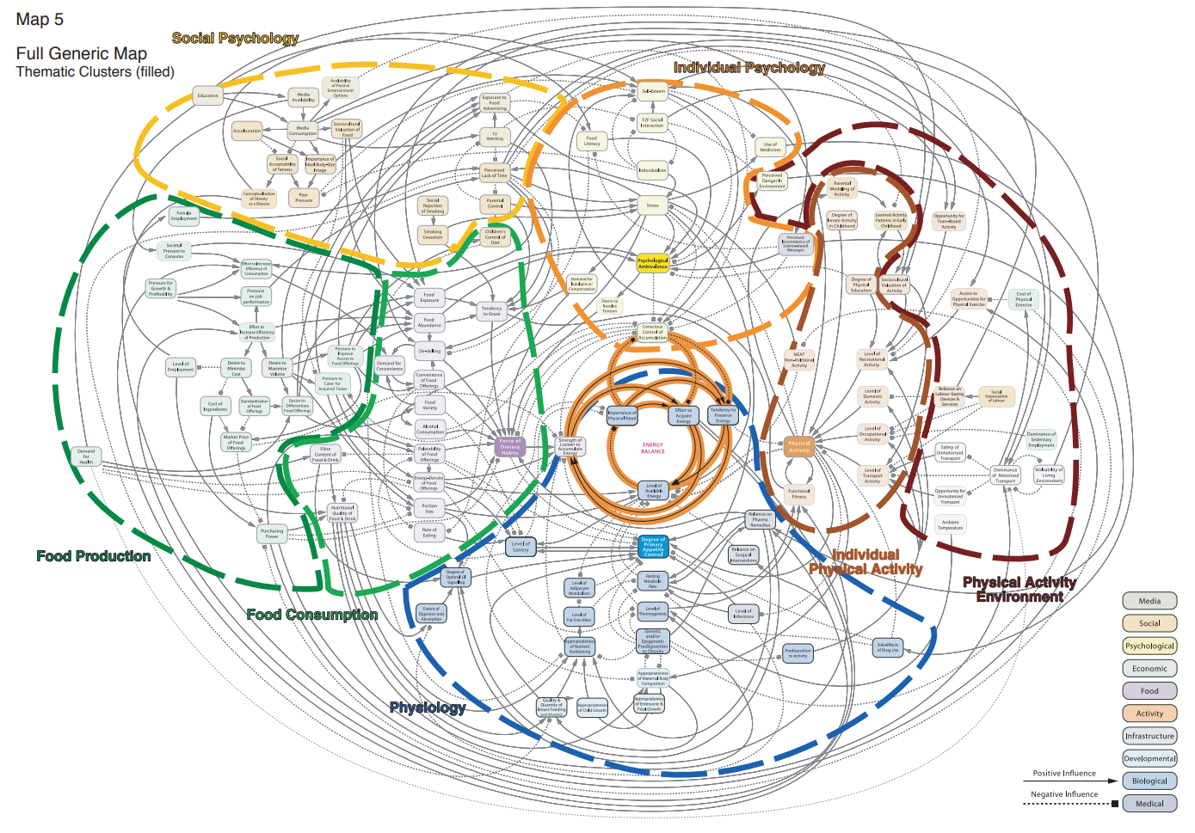
(Vandenbroeck et al, 2007)

Slide 6
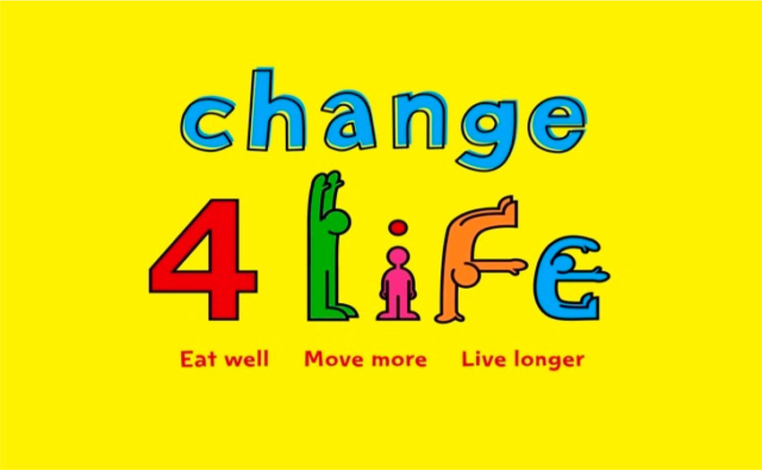
Context
First ever social marketing campaign to ↓ obesity
“A society-wide movement that aims to prevent people from becoming overweight by encouraging then to eat better and move more”; launched 2009
Annual campaigns and subsidiary campaigns e.g.:
Swap when you shop app
10-minute shake up app
Be Food Smart
Sugar Smart https://www.thensmc.com/resources/showcase/change4life

Slide 7
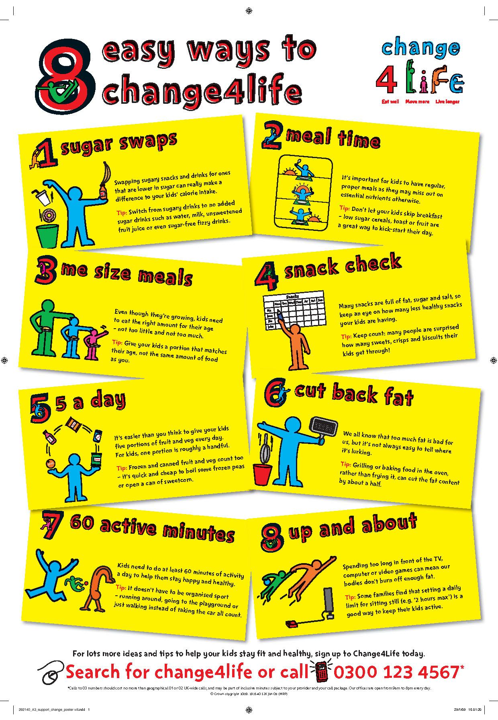
Approach
Reframe the issue - raise awareness of weight & associated health issues
Personalise the issue - weight gain may be an issue for “MY” family
Root behaviours – 8 desired behaviours (children)
Inspire change & support people

Slide 8
Evolution of Change4Life
Target: parents of children aged 5-11 years
https://www.youtube.com/watch?v=zBnLC4ti8cA&t=12s
Y2: Start4Life sister brand to promote healthy habits from birth
Target audience now includes adults
Now Better Health, Better Families https://www.nhs.uk/healthier-families/
Cost:
  Originally £75 million over 3 years but annual budget cut to £10.9 million
Partners:
  NGOs: CRUK, Diabetes UK, BHF
  Commercial: Tesco, Asda, PepsiCo, Kelloggs
  Media: ITV
  Industrial groups: Association of Convenience stores and fitness industry association

Slide 9
Desirable behaviours
Change4Life: 5 desirable adult behaviours (diet) & 1 PA
Start4Life: 6 desirable behaviours for infants/mothers (5 diet & 1 PA)
Portion swap
Snack swap
5-a-day
Fibre swap
150 active minutes
Drink swap
Initiate breastfeeding
Continued breastfeeding
Delayed weaning
Wide range of age-appropriate foods
Avoid added sugar
Physical activity for babies

Slide 10
Desired outcomes of Change4Life
 | Increase awareness | Reduce unhealthy behaviour | Promote healthy behaviour
Diet | Be aware of the risk of consuming high levels of fat & sugar Understand health risks of poor diet | Reduce overall calorie intake and develop healthier eating habits | Increase fruit and vegetable intake (5-a-day)
 |  | Reduce frequency of snacking, instead opt for regular balanced meals
 |  | Reduce foods high in fat, particularly high in fat
 |  | Reduce foods and drinks high in added sugar
Physical activity | Health & personal benefits of being active | Avoid prolonged periods of inactivity or sedentary behaviour | Increase regular physical activity, especially parent/child activities

Slide 11
Suitable evidence of outcomes?
Outcome | Evidence
Awareness of risk of high fat intake & health outcomes | Market research (e.g. Kantar)
Diet ↓ calorie intake and develop healthy eating habits ↓ frequency of snacking & opt for regular balanced meals ↓ foods high in fat (esp saturated fat) ↓ foods/drinks high in added sugar ↑ fruit and veg intake | PHOF NDNS DEFRA (household consumption) Health Survey for England
Physical activity Avoid sedentary behaviour ↑ physical activity | PHOF Health Survey for England Sport England Active Lives survey

Slide 12
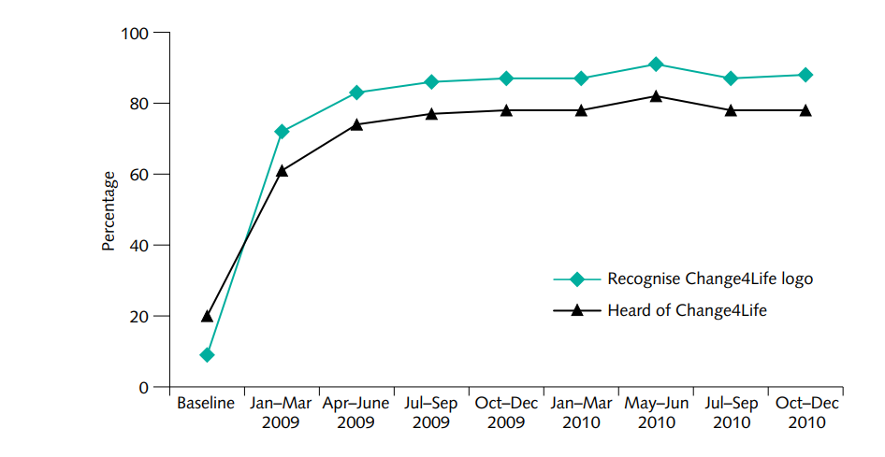
(DH, 2011)

Slide 13
Summary of achievements vs outcome
Desired outcome | Measures
Awareness of risk of high dietary fat & health outcomes | 400,000 joined in first year High brand/logo awareness High proportions report “thinking” about diet/PA & health 25% report taking action
Dietary data ↓ calorie intake & develop healthy eating habits ↓ frequency of snacking & opt for regular balanced meals ↓ foods high in fat (esp sat fat) ↓ foods/drinks high in added sugar ↑ fruit and veg intake | Child EI ↓ but ↑ obesity in children & adults Snack foods contribute same energy to diet Proportion of fat is same but saturated fat has ↓ in children (0.4% in 8 years)
Physical activity Avoid sedentary behaviour ↑ physical activity | Sedentary behaviour ↓ in adults

Slide 14
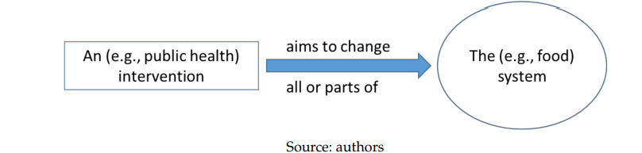
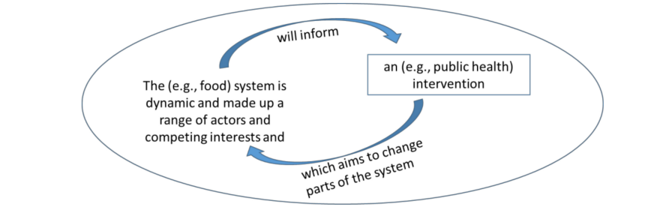
Conventional concept of a public health intervention
Systems approach, where the intervention is also part of the system (Knai et al, 2018)

Slide 15
Partnership: Responsibility Deal
Launched in 2011 (Coalition Government)
Aimed to get businesses working in partnership towards health & wellbeing targets
Pledges: alcohol, food, health @ work, physical activity & behaviour change
Food pledges:
Action to reduce salt (e.g. reformulation, chef training, salt availability)
Action to reduce calories (e.g. reformulation, portion sizes, education, marketing)
Action to encourage fruit & vegetable consumption (positive environment)
Calorie information provision in out-of-home setting
Exclusion of artificial trans fats
https://webarchive.nationalarchives.gov.uk/ukgwa/20130104160351/http://responsibilitydeal.dh.gov.uk/2011/12/20/food-pledges/

Slide 16
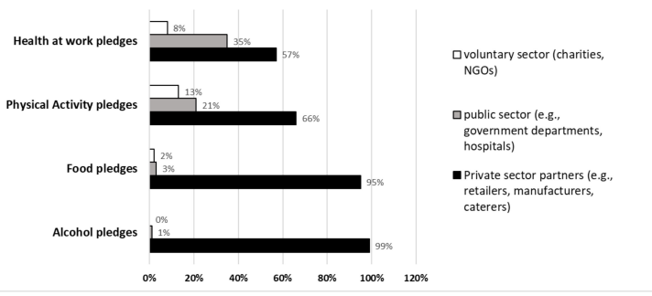
Success?
Government claimed success
Review found limited evidence: business as usual & pledges made were not those which would be most effective in improving diets (Knai et al, 2015)
(Knai et al, 2018)

Slide 17
Regulation
Calorie labelling (out of home):
Commitment July 2020; Legislation July 2021
Introduced April 2022
Small reduction in average energy content of menu items (replacement of higher calorie with lower calorie items) (Essman et al, 2025)
Promotion (volume price) & placement of HFSS:
Commitment July 2020, planned implementation April 2022
Delayed until October 2022; Legislation December 2021
May 2022 delay to volume price promotions until October 2023
June 2023, delay until October 2025
Location promotions came into effect October 2022
Junk food ads on TV and online:
Scope June 2025; from 5 Jan 2026

Slide 18
Regulation
Location promotions:
Impact of location regulation: reduction in HFSS in-store sales by 0.63% (Jenneson et al, 2025)
Lack of awareness of shoppers; supportive but importance of affordability emphasised (Kininmonth et al, 2025a)
Stakeholders supportive but concerns about complexity of interpretation & implementation and practical issues (Kininmonth et al, 2025b)
Potential impact on reformulation (Dhuria et al, 2025)
Banning sales of high-caffeine energy drinks to <16 years:
Commitment July 2024; Consultation closed November 2025

Slide 19
Reformulation
SACN (2015) recommended sugar reduction to ≤5% daily EI
PHE (2015) recommended: sugar reduction programme, restrictions on advertising & promotions, tax on high sugar food & drink
Sugar reduction programme (2016): challenged industry to reduce sugar in foods that contribute most to children’s intakes (<18 years) by 20% by 2020.
Guidelines published 2017.
2018: juice & milk-based drinks added. Challenge: reduce sugar by 5% & 20% respectively from baseline by mid-2021.
Guidelines published 2018.

Slide 20
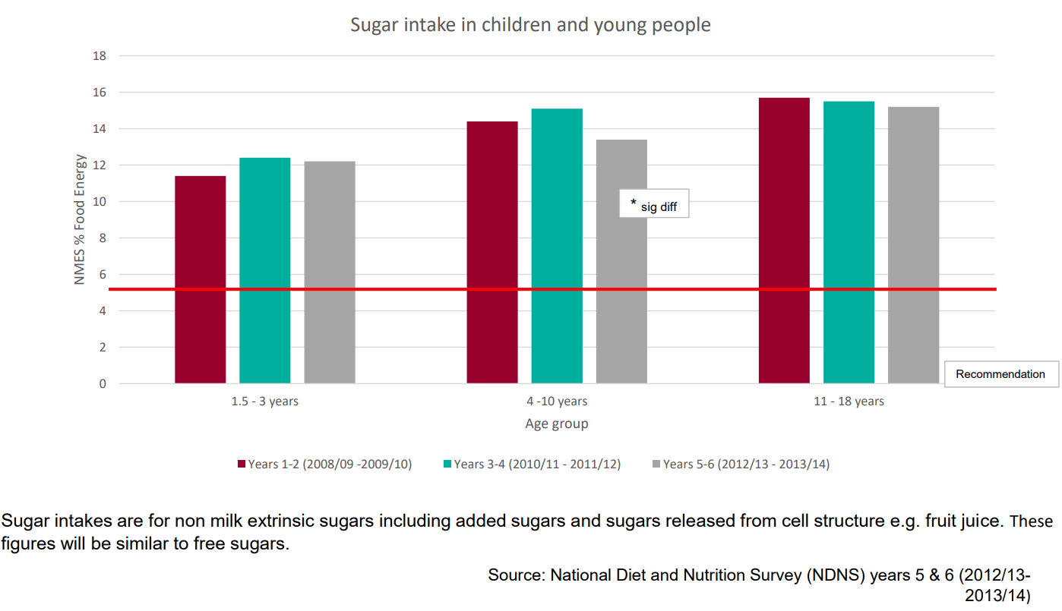

Slide 21
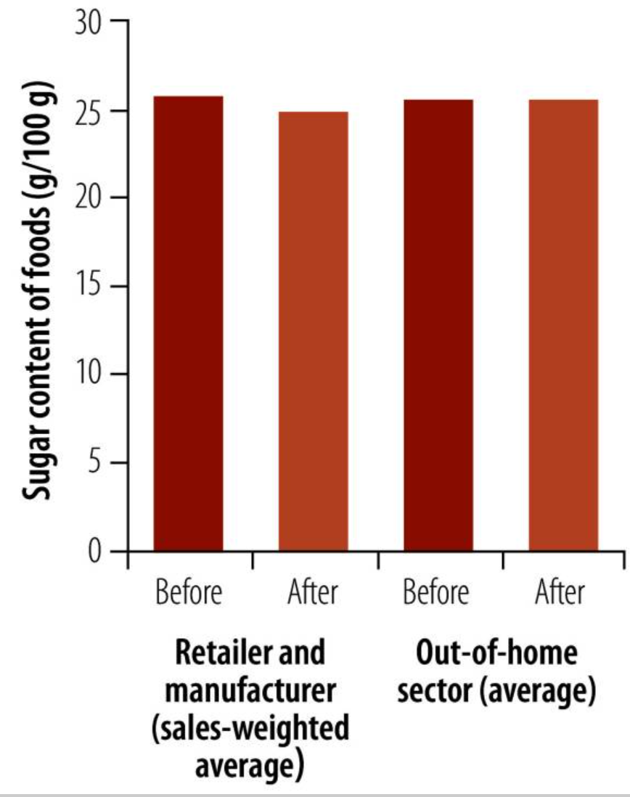
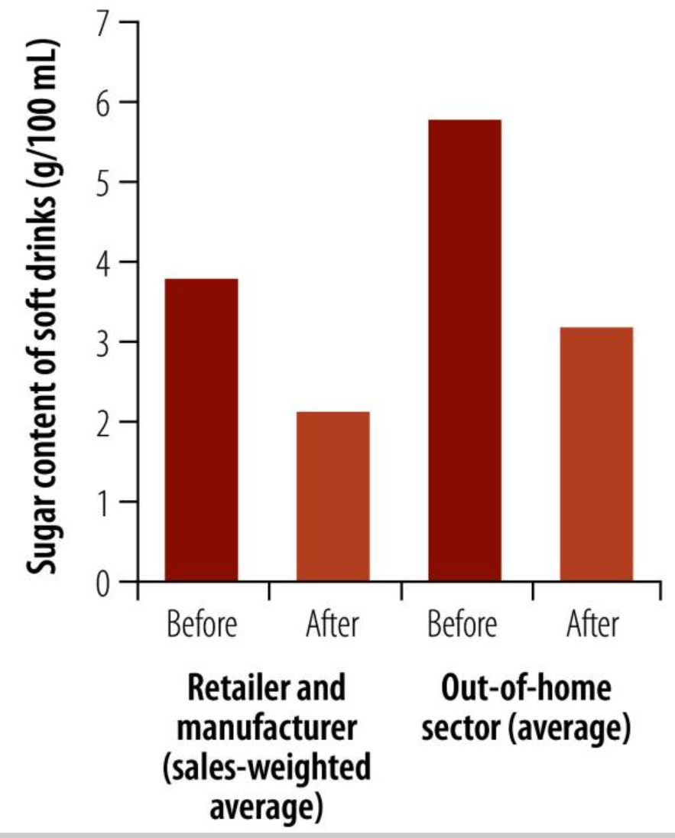
Impact of SDIL & sugar reformulation
-44.7% & -44.8% (2015-2020 & 2017-2020)
-3.5% & -1% (2015-2019)
(Hashem et al, 2024; OHID, 2022)

Slide 22
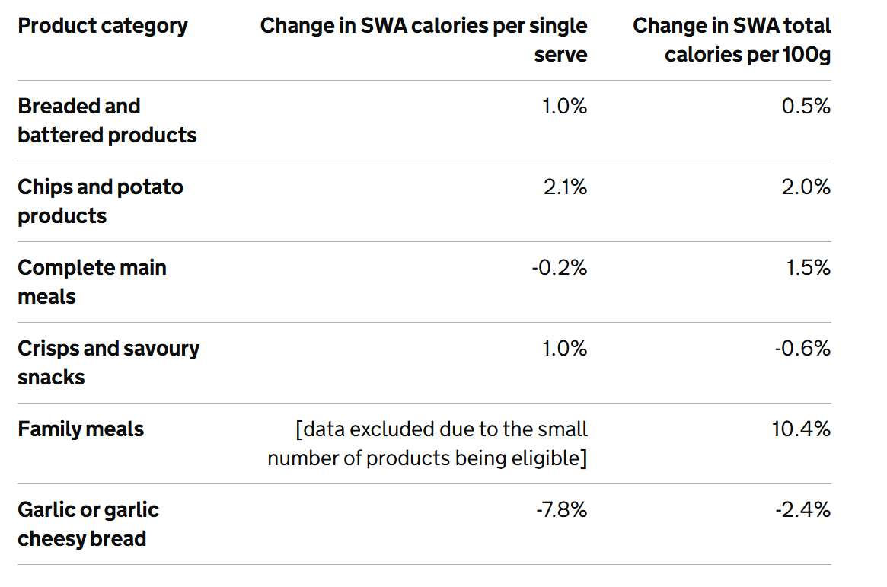
Calorie reduction programme
Intention to set out calorie reduction announced 2016
PHE commissioned 2017
PHE (2018) - evidence, ambition, scope & timeline
PHE (2020) – guidelines for industry published
(OHID, 2024)

Slide 23
Soft Drinks Industry Levy (SDIL)
Announced 2016; effective 2018
Three categories: drinks <5g sugar/100mls, 5-8g sugar/100 mls & drinks ≥8g/100mls sugar/100mls
Decision to extend scope & reduce cut-off to 4.5g/100mls from Jan 2028 made Nov 2025
Impact:
2015-2019: 65% of drinks >5g/100mls reformulated to <5g/100mls
47% reduction in sugar in soft drinks in scope of levy 2015-2024
12% reduction hospital admissions for dental caries tooth extractions children 0-18years; 0-4yrs: 28.6% reduction & 5-9yrs: 5.5% reduction (Rogers et al, 2023)

Slide 24
Weight loss programmes & support
NHS Digital Weight Management Programme
NHS Diabetes Prevention Programme (Healthier You)
NHS Couch to 5K
NHS Food Scanner app
NHS Weight Plan app

Slide 25
Obesity medication
Name | Brand name | Dose/frequency | Type | Action/s
Orlistat (prescription) | Xenical | 120mg/tds | Lipase inhibitor | ↓ gut absorption of dietary fat
Orlistat (OTC) | Alli | 60mg/tds | Lipase inhibitor | ↓ gut absorption of dietary fat
Semaglutide (prescription) | Wegovy | 1/week | GLP-1 RA | ↓ appetite
Tirzepatide (prescription) | Mounjaro | 1/week | GLP-1 & GIP RA | ↓ hyperglycaemia, ↓ appetite
Liraglutide (prescription) | Saxenda | 1/day | GLP-1 RA | ↓ appetite

Slide 26
Issues
ST regulation for LT conditions
Access & availability – MHRA warning
Cost
Nutritional issues

Slide 27
Conclusions
Multiple different approaches being taken
Traditionally most rely on individual behavioural change
Previously action to change obesogenic environment voluntary (limited impact)
Regulatory effects shown to have more impact
New treatments for excess weight have issues - nutritional impacts, ST availability, accessibility & cost
No single approach will be enough

Slide 28
References
Balogun B et al (2023). Obesity Policy in England. House of Commons Library Research Briefing. https://researchbriefings.files.parliament.uk/documents/CBP-9049/CBP-9049.pdf
DH (2011) Change4Life Three Year Social Marketing Strategy. https://assets.publishing.service.gov.uk/media/5a7baa68e5274a7318b9020a/dh_130488.pdf
Dhuria P et al (2025). “It will sort of drive us to rethink our approach to high fat salt sugar products”‑ a qualitative analysis of businesses’ reactions to the landmark Food (Promotion and Placement) Regulations in England. BMC Medicine 23: 576
Essman M et al (2025). Changes in energy content of menu items at out-of-home food outlets in England after calorie labelling policy implementation: a pre–post analysis (2021–2022). BMJ Public Health 3: e001905
Hardy A & Assher J (2011) Recipe for success with Change4Life. Market Leader Q1:24-27.
Hashem KM et al (2024). Outcomes of sugar reduction policies, United Kingdom of Great Britain and Northern Ireland. Bull World Health Organ.102(6): 432-439.
Jenneson VL et al (2025) Did High in Fat, Sugar, and Salt (HFSS) product placement legislation in England lead to reduced HFSS purchases? An interrupted time series analysis. OSF Preprints https://osf.io/preprints/osf/j6b8p_v1
Kininmonth AR et al (2025a). Customer awareness and perceptions of the high in fat, sugar, and salt (HFSS) placement legislation and impacts on self-reported food purchasing. Food Policy 135: 102941

Slide 29
Kininmonth AR et al (2025b). “It was a force for good but...”: a mixed-methods evaluation of the implementation of the High in Fat, Sugar and Salt (HFSS) legislation in England. OSF Preprints https://osf.io/preprints/osf/3xjtv_v1
Knai C et al (2018). The Public Health Responsibility Deal: Using a Systems-Level Analysis to Understand the Lack of Impact on Alcohol, Food, Physical Activity, and Workplace Health Sub-systems. Int J Env Res & Public Health 15: 2895.
Knai C et al (2015). Has a public–private partnership resulted in action on healthier diets in England? An analysis of the Public Health Responsibility Deal food pledges. Food Policy 54: 1-10.
OHID (2024). Calorie reduction programme: industry progress 2017 to 2021. https://www.gov.uk/government/publications/calorie-reduction-programme-industry-progress-2017-to-2021/calorie-reduction-programme-industry-progress-2017-to-2021
OHID (2022). Sugar reduction – industry progress 2015 to 2020. https://assets.publishing.service.gov.uk/media/6388cd71d3bf7f328c0ded27/Sugar-reduction-and-reformulation-progress-report-2015-to-2020.pdf
Rogers NT et al (2023). Estimated impact of the UK soft drinks industry levy on childhood hospital admissions for carious tooth extractions: interrupted time series analysis. BMJ Nutrition, Prevention & Health: e000714. https://doi.org/10.1136/bmjnph-2023-000714
Stiebahl S (2025). Obesity statistics. Research briefing. House of Commons Library. https://commonslibrary.parliament.uk/research-briefings/sn03336/
Vandenbroeck IP et al (2007). Tackling Obesities: Future Choices – Obesity System Atlas. https://assets.publishing.service.gov.uk/media/5a7b8811ed915d4147620fb2/07-1177-obesity-system-atlas.pdf

